Slide 1
Project
Presented By
R.THANGA SHYAMALA – CSE DEPT
HOLYCROSS ENGINEERING COLLEGE

Slide 2
CONTENT
INTRODUCTION
PHISHING ATTACK
TYPES OF PHISHING ATTACK
WORKING
EXAMPLES OF PHISHING ATTACK
HOW TO PREVENT PHISHING ATTACK
SOCIAL ENGINEERING
IMPACT OF SOCIAL ENGINEERING ATTACKS
IMPORTANCE OF EMPLOYEE TRAINING
CONCLUSION

Slide 3
TitLE - Phishing Attack Incident in Real Time or online financials scams:
Examine a real-world case where a phishing attack compromised sensitive information in an organization. Discuss preventative measures and employee training programs to ensure the risks of social engineering attacks.

Slide 4
phishing aTTACK
Phishing attacks are fraudulent emails, text messages, phone calls or websites that are designed to trick users into downloading malware, sharing sensitive information or personal data (for example, Social Security and credit card numbers, bank account numbers, login credentials), or taking other actions that expose themselves or their organizations to cybercrime.
Successful phishing attacks often lead to identity theft, credit card fraud, ransomware attacks, data breaches and huge financial losses for individuals and corporations.
Phishing is the most common type of social engineering, the practice of deceiving, pressuring or manipulating people into sending information or assets to the wrong people. Social engineering attacks rely on human error and pressure tactics for success. The attacker masquerades as a person or organization the victim trusts—for example, a coworker, a boss, a company the victim or victim’s employer deals with—and creates a sense of urgency that drives the victim to act rashly. Hackers and fraudsters use these tactics because it’s easier and less expensive to trick people than it is to hack into a computer or network.

Slide 5
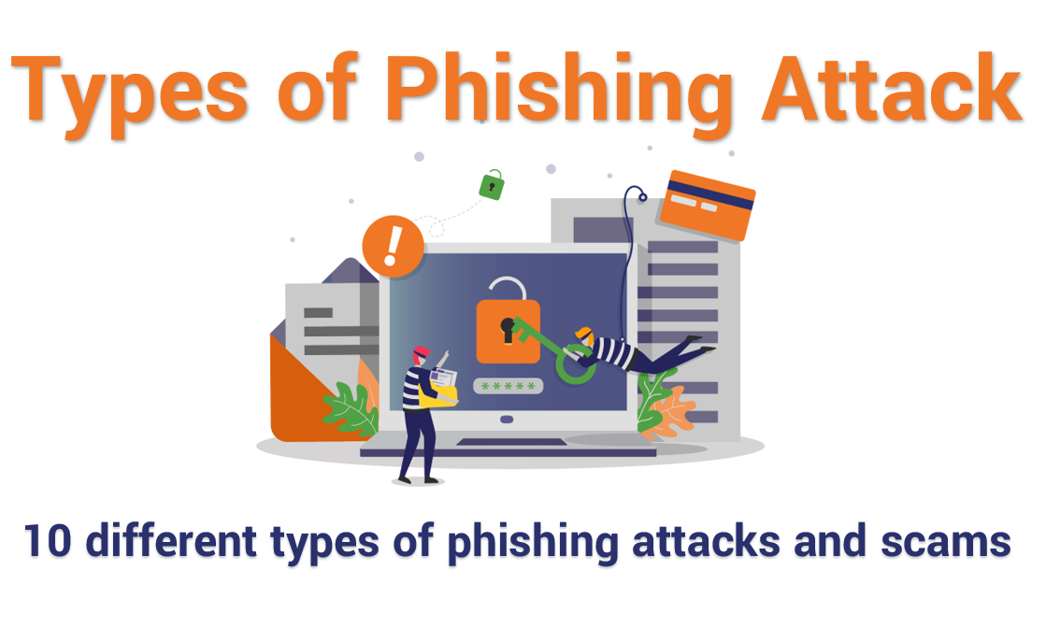

Slide 6
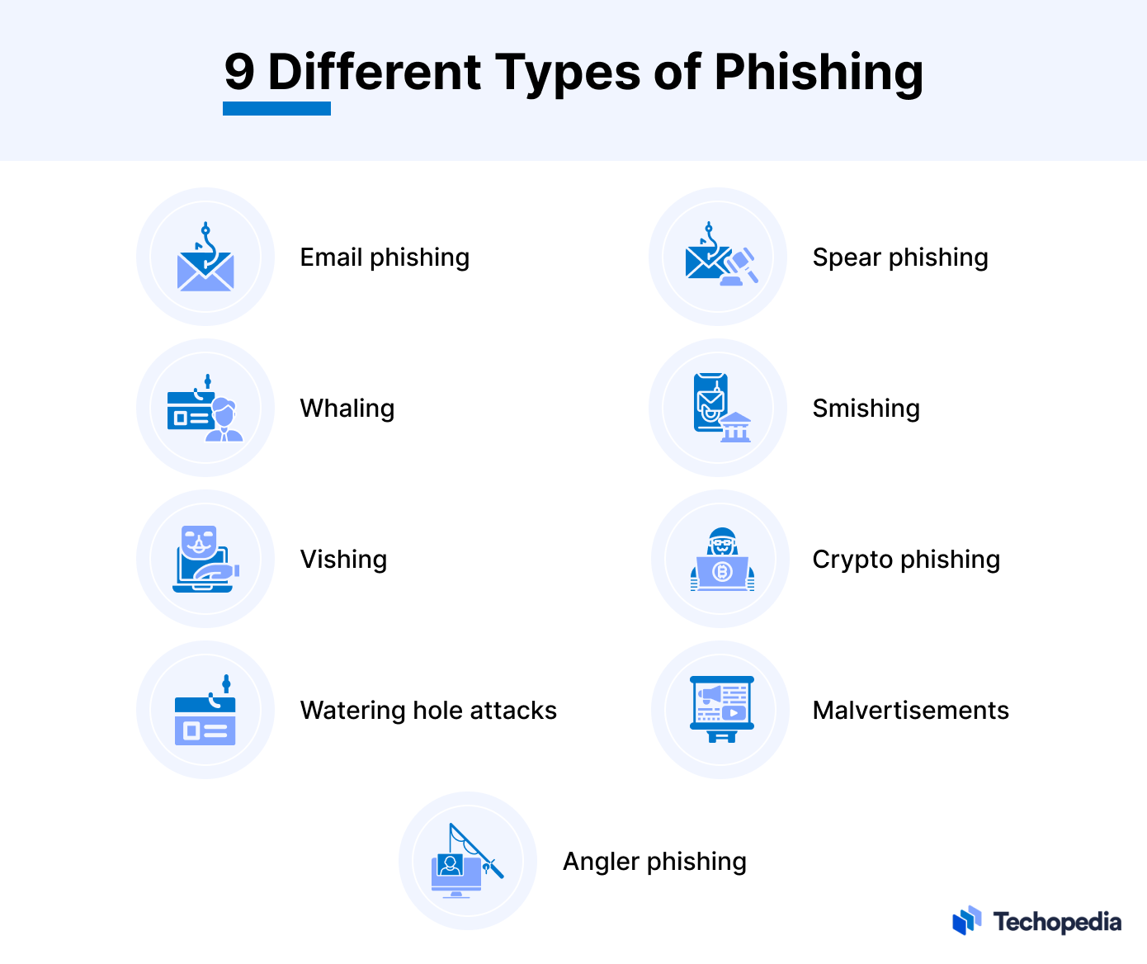
9

Slide 7
Email phishing scams
Email phishing is a numbers game. An attacker sending out thousands of fraudulent messages can net significant information and sums of money, even if only a small percentage of recipients fall for the scam. As seen above, there are some techniques attackers use to increase their success rates.
For one, they will go to great lengths in designing phishing messages to mimic actual emails from a spoofed organization. Using the same phrasing, typefaces, logos, and signatures makes the messages appear legitimate.
In addition, attackers will usually try to push users into action by creating a sense of urgency. For example, as previously shown, an email could threaten account expiration and place the recipient on a timer. Applying such pressure causes the user to be less diligent and more prone to error.

Slide 8
Spear phishing
Spear phishing targets a specific person or enterprise, as opposed to random application users. It’s a more in-depth version of phishing that requires special knowledge about an organization, including its power structure.
An attack might play out as follows:
A perpetrator researches names of employees within an organization’s marketing department and gains access to the latest project invoices.
Posing as the marketing director, the attacker emails a departmental project manager (PM) using a subject line that reads, Updated invoice for Q3 campaigns. The text, style, and included logo duplicate the organization’s standard email template.
A link in the email redirects to a password-protected internal document, which is in actuality a spoofed version of a stolen invoice.
The PM is requested to log in to view the document. The attacker steals his credentials, gaining full access to sensitive areas within the organization’s network.
By providing an attacker with valid login credentials, spear phishing is an effective method for executing the first stage of an APT.

Slide 9
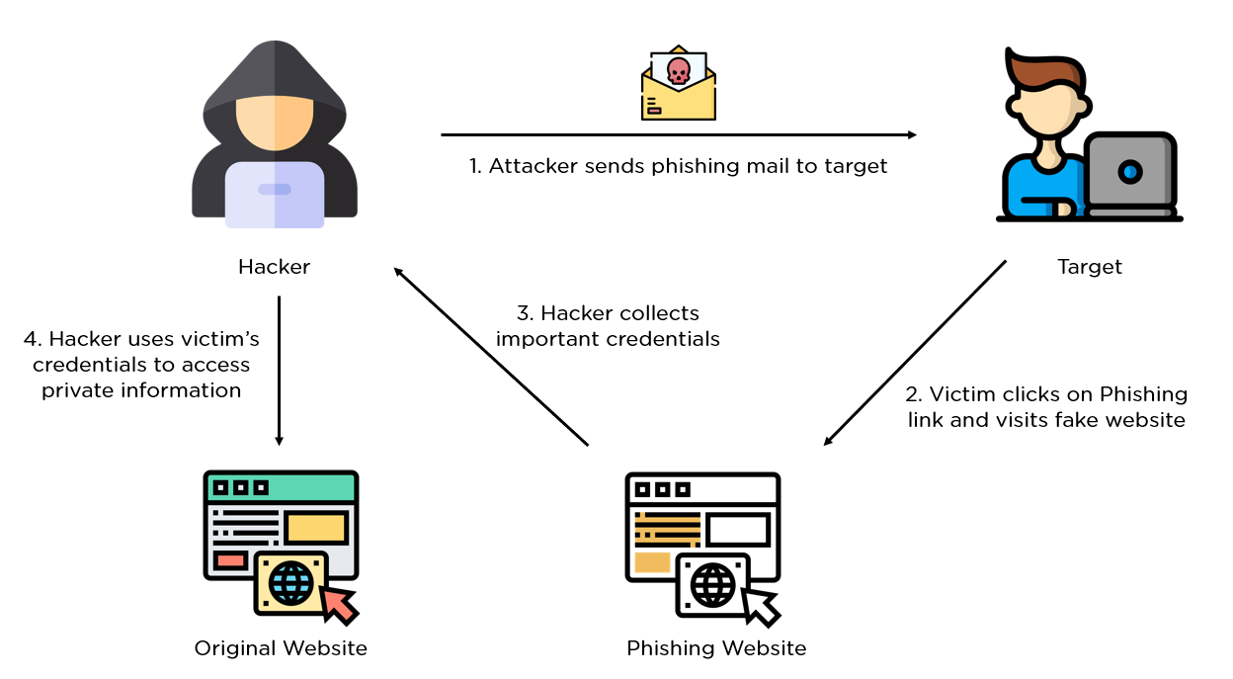
WORKING

Slide 10
EXAMPLES OF PHISHING ATTACK
A spoofed email ostensibly from myuniversity.edu is mass-distributed to as many faculty members as possible.
The email claims that the user’s password is about to expire. Instructions are given to go to myuniversity.edu/renewal to renew their password within 24 hours.

Slide 11
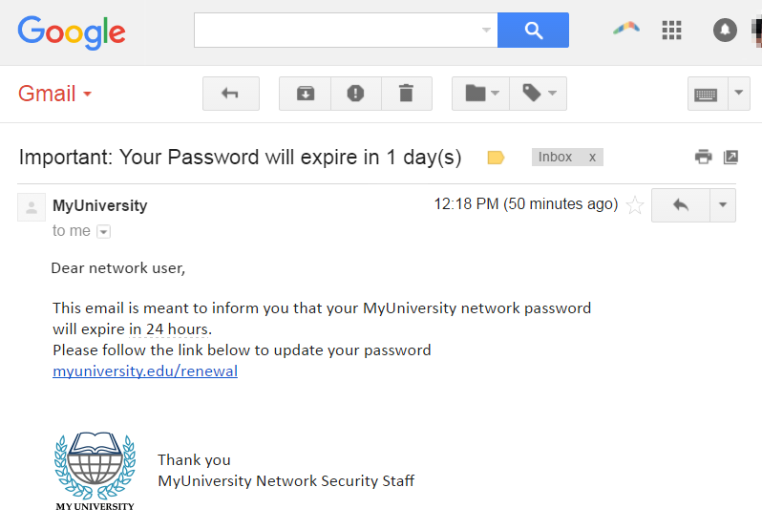
EXAMPLE

Slide 12
How to prevent phishing
Implement appropriate technical measure
Build a positive security culture
Learn the psychological triggers
Train your staff
Test the effectiveness of the training

Slide 13
EXPLANATION
Implement appropriate technical measures
Use robust cyber security practices to prevent as many phishing attempts as possible from getting through your defences and ensure that, if they are successful, they don’t get much further.
Build a positive security culture
Recognise that social engineering is successful because its perpetrators are good at manipulation. Don’t punish staff for falling victim but encourage them to report incidents. If there is a culture of blame, your employees will not admit to what is perceived as a mistake, putting your organisation at far greater risk.
Learn the psychological triggers
All social engineering attacks exploit human psychology to get past victims’ natural wariness, such as:
Creating a false sense of urgency and heightened emotion to confuse their victims;
Exploiting the human propensity for reciprocation by creating a sense of indebtedness; or
Relying on conditioned responses to authority by seeming to issue orders from senior figures.

Slide 14
Train your staff
Any staff member might succumb to a phishing attack, so all employees need to be aware
of the threat they face.
Regular staff awareness training will help everyone understand the signs of a phishing attack
and its potential consequences. They will then be able to report potential phishing emails,
according to company policy.
Test the effectiveness of the training
Simulated phishing attacks will help you determine the effectiveness of the staff awareness
training and which employees might need further education.

Slide 15
SOCIAL ENGINEERING
Social engineering refers to the manipulation of individuals to gain unauthorized access to confidential information or networks. It involves exploiting human psychology and trust to deceive people into performing actions that benefit the attacker. Social engineering attacks can take various forms, including impersonation, pretexting, baiting, and tailgating.

Slide 16
Impact of Social Engineering Attacks
Social engineering attacks can have severe consequences for both individuals and organizations. Some potential impacts include:
Data breaches leading to unauthorized access to sensitive information.
Financial losses due to fraudulent transactions or ransom demands.
Customer trust has been lost as a result of reputational damage.
Legal and regulatory implications for organizations failing to protect confidential data.
Disruption of business operations and productivity.

Slide 17
Importance of Employee Training
Given the critical role that employees play in an organization’s defense against phishing attacks, comprehensive and ongoing training is essential. Employee training serves as a proactive approach to strengthen an organization’s cybersecurity posture.
Risk Mitigation: Training helps employees recognize the signs of phishing attacks and equips them with the knowledge to respond appropriately. This significantly reduces the risk of successful phishing attempts.
Behavioral Change: Effective training programs can instill a security-conscious culture within the organization. Well-trained employees are more likely to adopt secure practices in their daily work, reducing the overall vulnerability to attacks.
Cost Savings: Preventing a successful phishing attack can save an organization substantial financial losses, legal liabilities, and reputation damage. Investing in training is a cost-effective way to protect against potential cyber threats.
Compliance: Many industries and regulatory bodies require organizations to implement cybersecurity training programs for employees. Compliance with these regulations is essential to avoid penalties and legal consequences.

Slide 18
Reporting Incidents and Suspicious Activities
Employees should be encouraged to report any incidents or suspicious activities
to the appropriate IT or security personnel promptly. Establishing clear reporting
channels and incident response procedures ensures swift action can be taken to
mitigate potential risks.
Incident Response and Recovery Measures
In the unfortunate event of a social engineering or phishing attack, organizations
should have robust incident response and recovery plans in place. These plans
should include isolating affected systems,conducting forensic investigations, and
restoring services while minimizing the impact on operations.

Slide 19
Conclusion
As social engineering and phishing attacks continue to evolve, it is essential for employees to be well-informed and vigilant. By understanding the techniques employed by cybercriminals and implementing preventive measures, organizations can significantly reduce the risk of falling victim to these attacks. Regular employee training, strong authentication practices, and a culture of security awareness are crucial components of a comprehensive defense strategy.

Slide 20


